Slide 1
2019
Musical Composition Style Transfer via Disentangled Timbre Representations
Yun-Ning (Amy) Hung
http://mac.citi.sinica.edu.tw/
biboamy@iis.sinica.edu.tw
Music & AI Lab, Research Center for IT Innovation, Academia Sinica

Slide 2
Introduction

Slide 3
Music Generation
Music Generation
Generate from scratch
MidiNet [2]
StructureNet [3]
BachProp [4]
MuseGAN [1]
….
Notes:
Before introducing our paper, I want to first talk about music generation.
Music generation has long been considered as an important task for AI. One of the trend for music generation is to generate music from scratch, which means generate original musical content without reference. We expect machines can learn the complex musical structure and compose music like human composers. There are many previous research focus on this topic such as MidiNet, StructureNet, BachProp, MuseGAN….etc.

Slide 4
Music Generation
Music Generation
Generate from scratch
Style
Transfer
Rearrangement
Genre
Harmonization
Instrument
https://www.youtube.com/watch?v=buXqNqBFd6E
Notes:
Another trend for music generation is to generate variations of existing musical material. We called it music arrangement style transfer. Which means to preserve the pitch contour while altering some other
score features, such as genre, instrumentation, harmonization, etc, in a meaningful way.
For example…..
In contrast to music generation, we have a song to reference.

Slide 5
Music Generation
Music Generation
Generate from scratch
Style
Transfer
A Genre
B Genre
RaGAN [7]
CycleGAN [5]
FusionGAN [6]
Notes:
There are few research on this topics such as RaGAN, FusionGAN and music CycleGAN. However, although so far all these research focus on genre style transfer, their models can’t not choose which instrument to use when generated a new song. However, instrumentation is an important task since different genre might use different instruments. For example, rock music often uses e-guitar and bass while country music has more a-guitar and violin. As a result, in our research, we tried to look into this topic, and narrow down the task into instrumentation style transfer.

Slide 6
Target - Obstacle
Target: Rearrangement style transfer, especially for instrumentation rearrangement
Obstacle: Not enough paired data demonstrating different instrumentations of the same music pieces
Notes:
So the goal is to rearrange the music by using different instrument
The biggest obstacle in this task is that there is no enough data to demonstrate different instrumentations of the same music pieces, so it’s hard to train a model for this task.
In order to solve this problem, we use paired MIDI and Audio as our training data since it’s more easy to get. We train a music transcription network to let model learn how the music pieces are composed and investigate “disentanglement techniques” for model to learn how to rearrange instrument by itself. In this work, we use the synthesized music.

Slide 7
Solution
Solution: Use paired MIDI and audio to train a music transcription network since this kind of data is easier to get. (We use synthesized music in our experiment)
Investigate disentanglement techniques so the model can learn how to rearrange instrument by itself.
Notes:
The biggest obstacle in this task is that there is no enough data to demonstrate different instrumentations of the same music pieces, so it’s hard to train a model for this task.
In order to solve this problem, we use paired MIDI and Audio as our training data since it’s more easy to get. We train a music transcription network to let model learn how the music pieces are composed and investigate “disentanglement techniques” for model to learn how to rearrange instrument by itself. In this work, we use the synthesized music.

Slide 8
Proposed Models

Slide 9
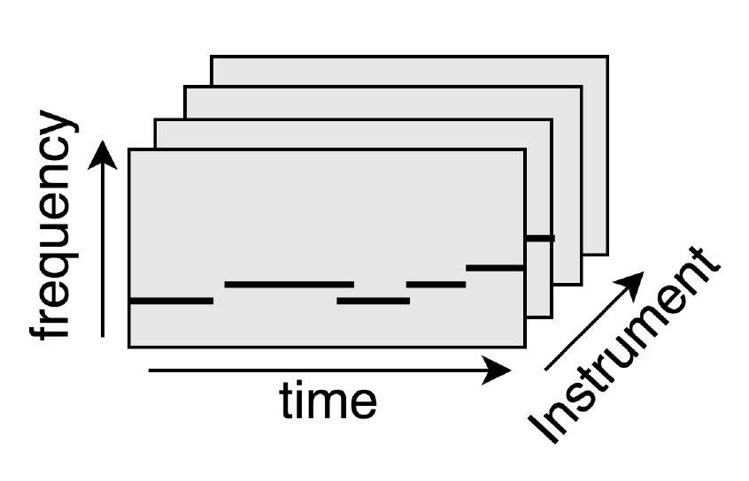
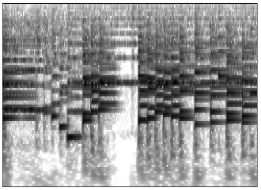
Music Disentanglement
Notes:
And this is the broad overview of our system. For a music transcription network. The input is an audio and the output is a score or pioanoroll.

Slide 10
Music Disentanglement
Timbre
(Instrument)
Binary
Pitch (Content)
Notes:
However, at the middle, we want our model to separate the information of different attributes. In our task, we separate instrument information from the content, a.k.a pitch. The idea is that by doing so, if we change the instrument part and preserve the content part, then we can force our model to change instrumentation without much affecting the content and realize rearrangement.

Slide 11
Music representation
Notes:
For a music audio, we can extract these three ground truth. pianoroll, a 3-D metric to represent which note is played by which instrument. Pitch roll: what kind of pitch is played in each time frame. Instrument roll: what kind of instrument is played in each time frame. and Pianoroll will be used as our target output. Instrument roll and pitch roll will be used in our model to help extract disentangled representation.

Slide 12
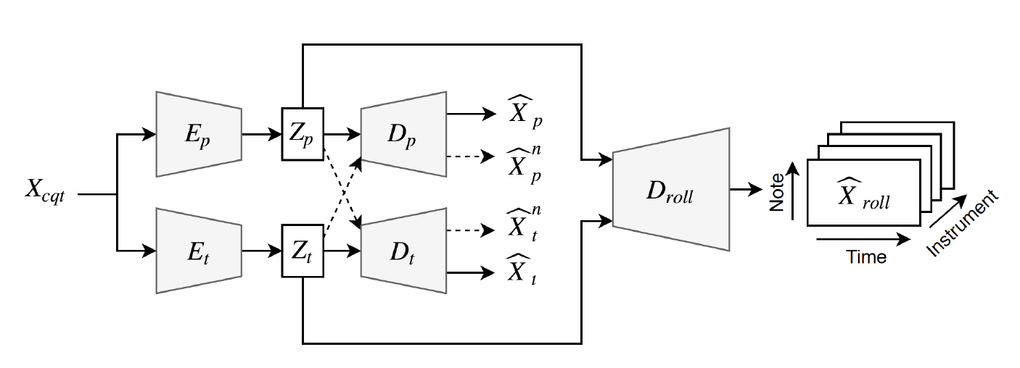
Proposed Model - DuoED
Notes:
In order to do the disentanglement, we proposed two model structures. First one is called DuoED. It is called Duo because it has two branches.

Slide 13
Proposed Model - DuoED
Liu, Yu, et al. "Exploring disentangled feature representation beyond face identification."
Notes:
Inspired by Liu, one branch extract information of pitch, which related to content into Zp while the other extract timbre information, which related to instrumentation into zt

Slide 14
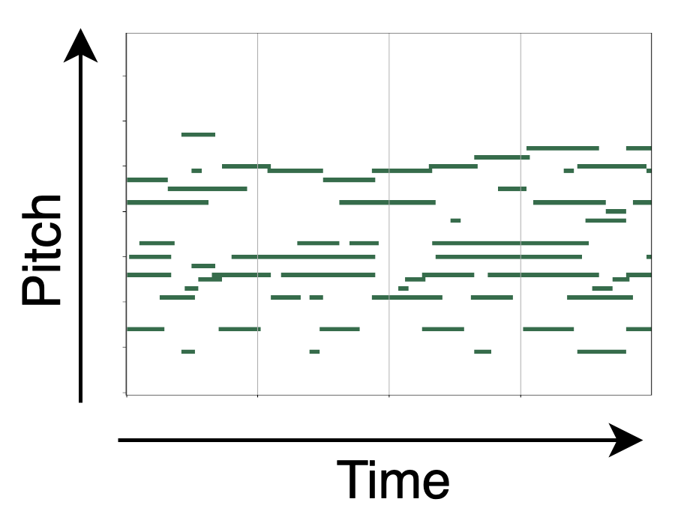
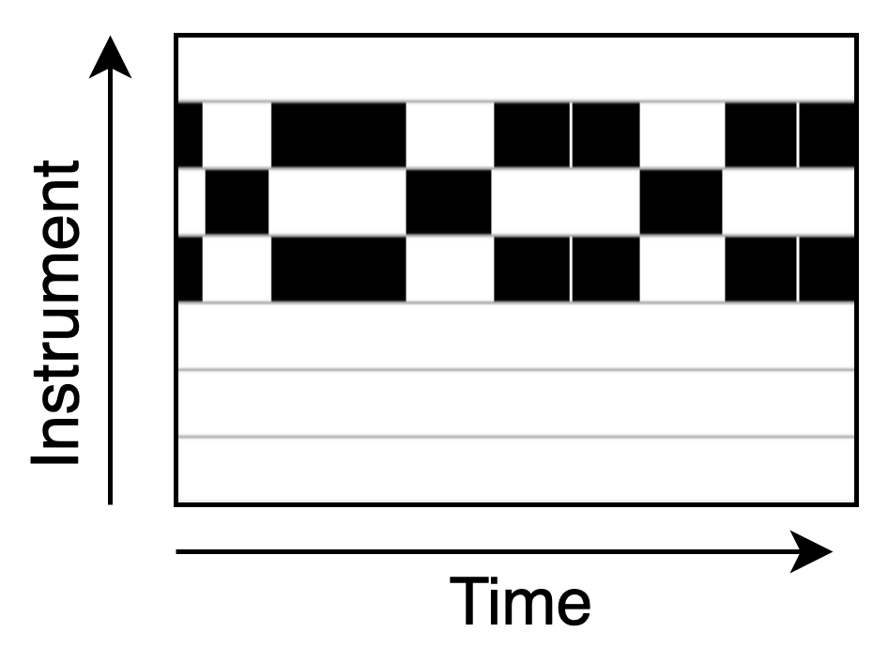
Proposed Model - DuoED
Notes:
Zp and Zt has decoder connected to predict instrument and pitch ground truth Xt and Xp, so it will guide the learning of this information

Slide 15
Proposed Model - DuoED
Adversarial Loss
Notes:
However, since we don’t want the instrument latent vector containing any pitch information and vice versa, we implement adversarial training by feeding the latent vector to the wrong decoder and calculate the adversarial loss. So the instrument vector will expel content information from instrument latent and the other way too. The details are in the paper so I am not going to explain more here.

Slide 16
Proposed Model - DuoED
Notes:
In the end, both instrument and content latent will be fed into pianoroll decoder to predict pianoroll.

Slide 17
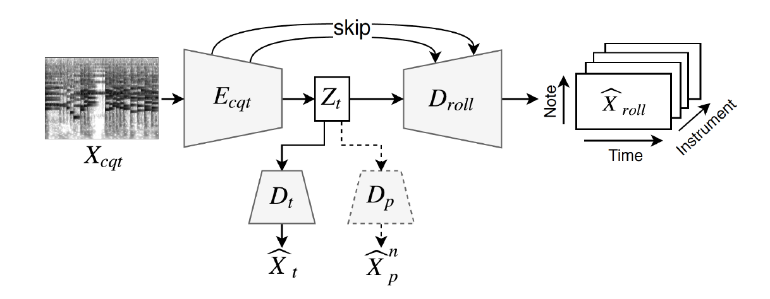
Proposed Model - UnetED
Notes:
Our second model is called UnetED, because it adapts Unet structure. We choose this model for disentanglement based on some domain knowledge for music.

Slide 18
Proposed Model - UnetED
Adversarial Loss
Notes:
We hope the bottom latent vector only contains instrument information. So except for predicting instrument ground truth, we also implement adversarial training to expel pitch information.

Slide 19
Proposed Model - UnetED
Pitch
Notes:
Then, since Zt is supposed not to carry pitch information, the only way to obtain the pitch information needed to predict pianoroll is from the skip connections. Second, it is fine to assume that the skip connections can pass over the pitch information, due to the nice one-to-one time-frequency correspondence between cqt and each frontal slice of pianoroll

Slide 20
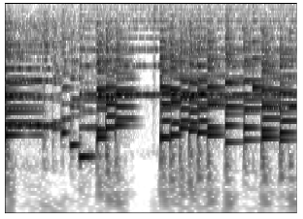
Proposed Model - UnetED
Timbre (texture)
Pitch (boundary)
Notes:
Moreover, in cqt pitch only affects the lowest partial of a harmonic series created by a musical note, while timbre affects all the partials. If we view pitch as the “boundary” outlining an object, and timbre as the “texture” of that object, detecting the pitches may be analogous to image segmentation, for which U-nets have been shown effective in solving

Slide 21
Rearrangement Implementation
Zt
Notes:
After training the model, ideally the instrument latent vector will be pitch-invariant. So if we want to realize rearrangement, we then replace Zt with another Zt which contains information from other instrumentation, so that the model will know how to arrange pitch with new instrument information.

Slide 22
Evaluation

Slide 23
Rearrangement
String Composition
Acoustic Composition
Zt
Zt
Zt
Zt
Zt
Zt
Zt
Zt
Zt
Zt
Zt
Zt
Zt
Zt
Zt
Zt
Piano
Band Composition
String Composition: Violin and Cello Band Composition: Chord, Bass and Melody
Piano: Piano only Acoustic composition: Guitar or Guitar and Melody
Notes:
When evaluating, we choose four types of common composition:
strings composition (i.e., violin and cello), piano, acoustic composition (i.e., guitar, or guitar and melody), and band composition (bass, melody chord). We then choose four songs from each group and randomly swapping the instrument latent vector.

Slide 24
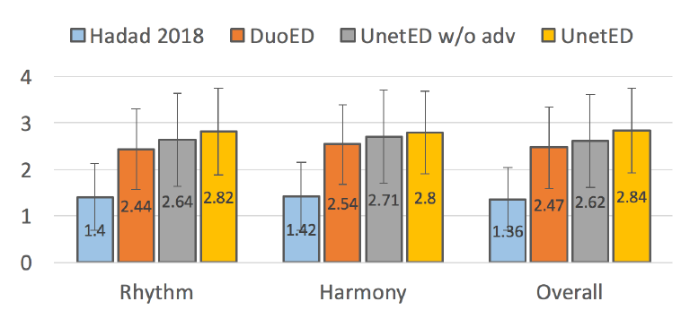
Rearrangement
Likert scale
Rhythm: Whether the composition sounds rhythmic
Harmony: Whether the composition sounds harmonic
Overall: The overall quality of the rearrangement
Likert scale: 4-point Likert scale, the higher the better
Hadad, Naama, Lior Wolf, and Moni Shahar. "A two-step disentanglement method." Proceedings of the IEEE Conference on Computer Vision and Pattern Recognition. 2018.
Notes:
Then we randomly choose 12 new generated songs for user study evaluation. We ask 40 subjects to evaluate these songs based on three values.We compared four types of models. UnetED, DuoED, ablated version of UnetED and Hadad 2018, which is a disentangled model for image. We use the same model structure but train on our own data. More information about the user study can be found in our paper.
We can see that Unet has the best performance on the three metrics.
Moreover, we found that there is no much difference between the ratings from people with music background and people without music
background. The only difference is that people with music background averagely tends to give slightly lower ratings.

Slide 25
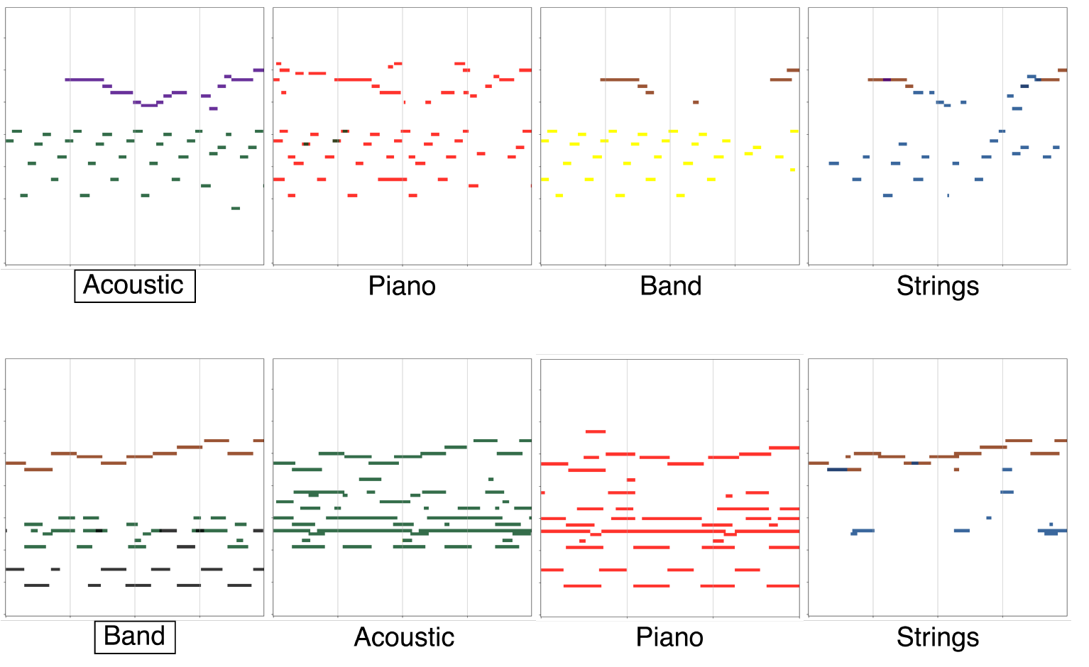
Rearrangement
Purple: flute Red: piano Black: bass Green: acoustic guitar
Yellow: electric guitar Blue: cello Brown: violin
Notes:
We then show the rearrangement result of UnetED.
We can see that when rearranging the music to be played by band, UnetED finds the low-pitched notes for the bass to play and the melody notes for the flute or violin to play and the chord played by guitar and piano. This demonstrates that UnetED has the ability to choose suitable instruments playing certain notes combination. This result is also showed in arranging string instruments.

Slide 26
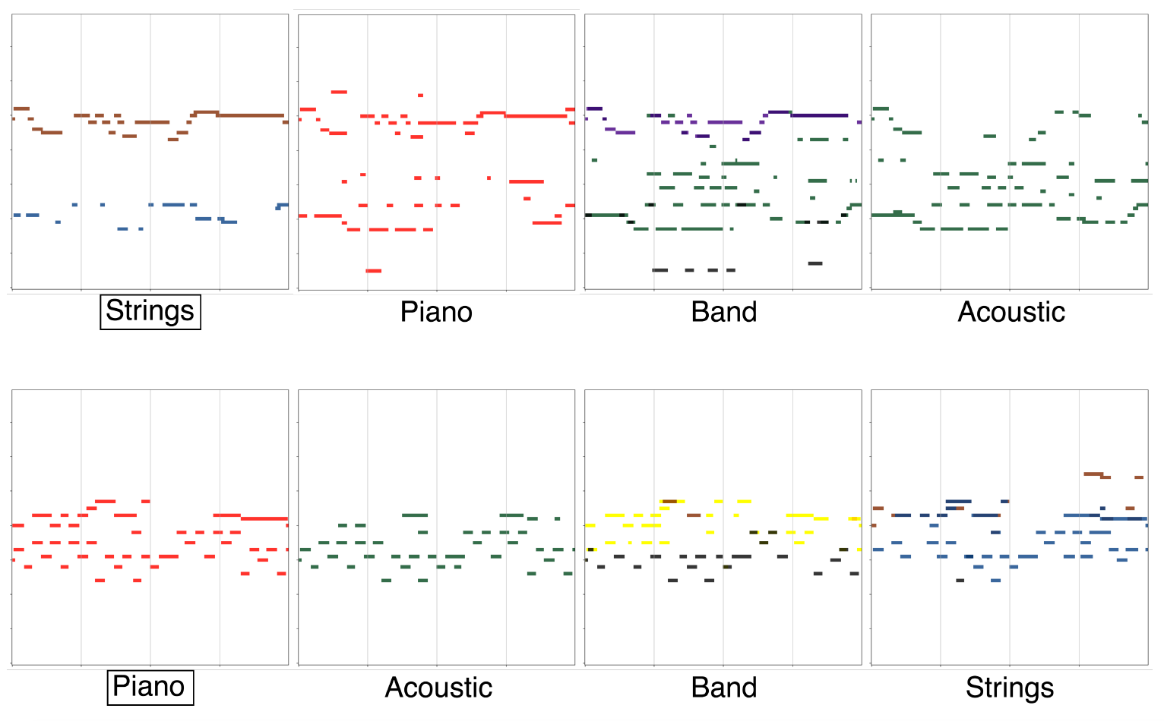
Rearrangement
Purple: flute Red: piano Black: bass Green: acoustic guitar
Yellow: electric guitar Blue: cello Brown: violin
Notes:
We then show the rearrangement result of UnetED.
We can see that when rearranging the music to be played by band, UnetED finds the low-pitched notes for the bass to play and the melody notes for the flute or violin to play and the chord played by guitar and piano. This demonstrates that UnetED has the ability to choose suitable instruments playing certain notes combination. This result is also showed in arranging string instruments.

Slide 27
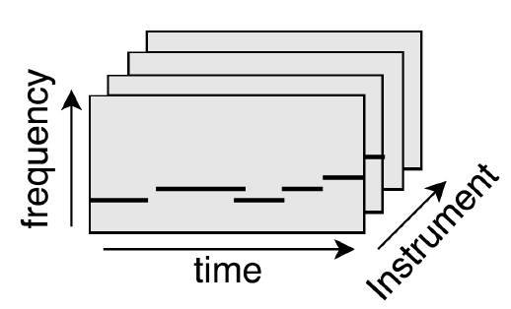
Rearrangement
UnetEDModel
New Score
Input song
Synthesizer
or
Audio Synthesis
model
New Audio
Notes:
Moreover, in the future, we can also connect the output score with synthesizer or audio synthesis model like performanceNet or GANSynth to output a music piece.

Slide 28
Rearrangement
Guitar
String
Piano
Band
String
Piano
Piano
String
Notes:
Here we only use synthesizer to synthesize the music and let you hear. Because the model has to transcript frist which is a difficult task for polyphonic music, and since it’s a synthesized music, the quality might not be that good, but can improve in the future. Here we just want to let you hear the raw output of the model.

Slide 29
Latent Analysis
MedleyDB
&
Mixing Secret
UnetEDModel
Zt
Notes:
Moreover, we also analyze whether the latent vector z has sufficient timbre information and can be used in other task. To do so, we first extract all the Zt from the song in MedleyDB and Mixing Secret.

Slide 30
Latent Analysis
MedleyDB
&
Mixing Secret
UnetEDModel
Zt
Instrument
Ground Truth
Decoder
Notes:
And then use the training set to train a decoder to predict frame-level instrument ground truth.

Slide 31
Latent Analysis
All the setting like testing and training set split and evaluation metrics are the same as the previous tasks on instrument activity detection
From the table we can see that using our latent vector as the input feature can get the highest score on five instruments recognitions.
Note that our model is trained on synthesized data while the task is evaluated on real-world audio

Slide 32
Conclusion
Propose two disentangled models for learning content invariant feature
By replacing the feature, we can realize music rearrangement
The invariant feature can also be used for instrument activity detection, or in the future, other task
Notes:
重點:
disentangled model for learning instrument in-variant feature
this model can be used for instrumentation style transfer
and also can be used for instrument prediction

Slide 33
[1] Dong, Hao-Wen, et al. "MuseGAN: Multi-track sequential generative adversarial networks for symbolic music generation and accompaniment." Thirty-Second AAAI Conference on Artificial Intelligence. 2018.
[2] Yang, Li-Chia, Szu-Yu Chou, and Yi-Hsuan Yang. "MidiNet: A convolutional generative adversarial network for symbolic-domain music generation." arXiv preprint arXiv:1703.10847 (2017).
[3] Medeot, Gabriele, et al. "StructureNet: Inducing Structure in Generated Melodies." ISMIR. 2018.
[4] Colombo, Florian, Johanni Brea, and Wulfram Gerstner. "Learning to Generate Music with BachProp." arXiv preprint arXiv:1812.06669 (2018).
[5] Brunner, Gino, et al. "Symbolic music genre transfer with cyclegan." 2018 IEEE 30th International Conference on Tools with Artificial Intelligence (ICTAI). IEEE, 2018.
[6] Chen, Zhiqian, et al. "Learning to fuse music genres with generative adversarial dual learning." 2017 IEEE International Conference on Data Mining (ICDM). IEEE, 2017.
[7] Lu, Chien-Yu, et al. "Play as You Like: Timbre-enhanced Multi-modal Music Style Transfer." arXiv preprint arXiv:1811.12214 (2018).

Slide 34
Thank you! Question?
Yun-Ning (Amy) Hung
http://mac.citi.sinica.edu.tw/
biboamy@iis.sinica.edu.tw

Slide 35
Question?
Why the input is audio not MIDI2MIDI

